Slide 1


Slide 2


CANTEEN MANAGEMENT SYSTEM
Second Year Project
Submitted by
ROLL | NAME
2301730009 | ADITYA KAMBOJ
2301730026 | AKSHIT TANWAR
2301730033 | TARUN SEHRAWAT
2301730018 | DARSHDEEP SINGH
Industry Mentor: Mr. Aman Singh
Faculty Mentor: Mr. Deepak Kaushik
Notes:
New Courses replaced with New Programmes

Slide 3
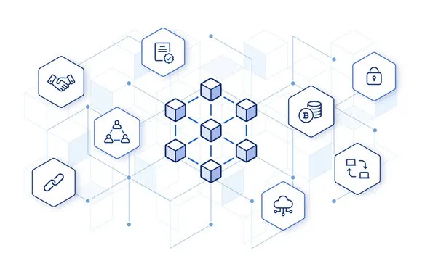

Project Overview
1. Introduction
The Canteen Management System is a software application designed to streamline daily operations of a canteen, including order management, menu updates, billing, and inventory tracking. It aims to reduce manual work, minimize errors, and speed up service for both staff and customers.
2. Objectives
To automate the order-taking process.
To maintain a digital record of menu items and prices.
To generate bills quickly and accurately.
To track inventory and reduce food wastage.
To improve customer experience by minimizing wait times.
3. Key Features
Menu Management: Easily update menu items, categories, and prices.
Order Management: Take, modify, and cancel orders efficiently.
Billing System: Automatic bill generation with tax calculations.
Inventory Management: Track stock levels and get alerts for low inventory.
Reports: Generate sales and inventory reports for analysis.
4. Technologies Used
Frontend: HTML, CSS, JavaScript
Backend: PHP / Node.js / Python (choose one based on your project)
Database: MySQL / MongoDB
Deployment: Local server (XAMPP) or Web Hosting
Notes:
New Courses replaced with New Programmes

Slide 4
Problem Statement
The college canteen plays a significant role in a student's daily routine, providing meals, snacks, and a place to unwind. However, managing canteen operations in a traditional manner often leads to challenges such as long waiting times, communication gaps, and inefficiencies in order handling. To address these issues, this project introduces a Digital Canteen System that simplifies and modernizes the entire process.
The system is designed to offer a seamless experience for both students and canteen staff. Students can browse the menu, place their orders, and make cashless payments directly through an intuitive website. They can also track their order status and provide feedback on the food and service. For canteen staff, the system ensures smooth order management, quicker preparation, and better coordination, reducing errors and delays.
Notes:
New Courses replaced with New Programmes

Slide 5
Objectives
Objective: To design and develop a responsive web page that streamlines and manages the operations of a canteen, allowing users to browse the menu, place orders, track order status, and manage payments digitally, reducing manual work and increasing efficiency.
Background: Traditional canteen operations are often manual, leading to issues like long queues, order confusion, inaccurate billing, and slow service. A web-based system will automate the process, making it convenient for both the customers and the canteen staff.
Key Requirements:
User Interface: A simple and user-friendly interface for browsing the menu and placing orders.
Menu Management: Admin can add, update, or remove items from the menu.
Order Placement: Customers can select items, add them to a cart, and place orders online.
Order Tracking: Customers can view the status of their orders (e.g., Preparing, Ready, Completed).
Payment Integration: Option for online payment or cash-on-delivery.
Admin Panel: For managing orders, menu items, and viewing sales reports.
Notes:
New Courses replaced with New Programmes

Slide 6
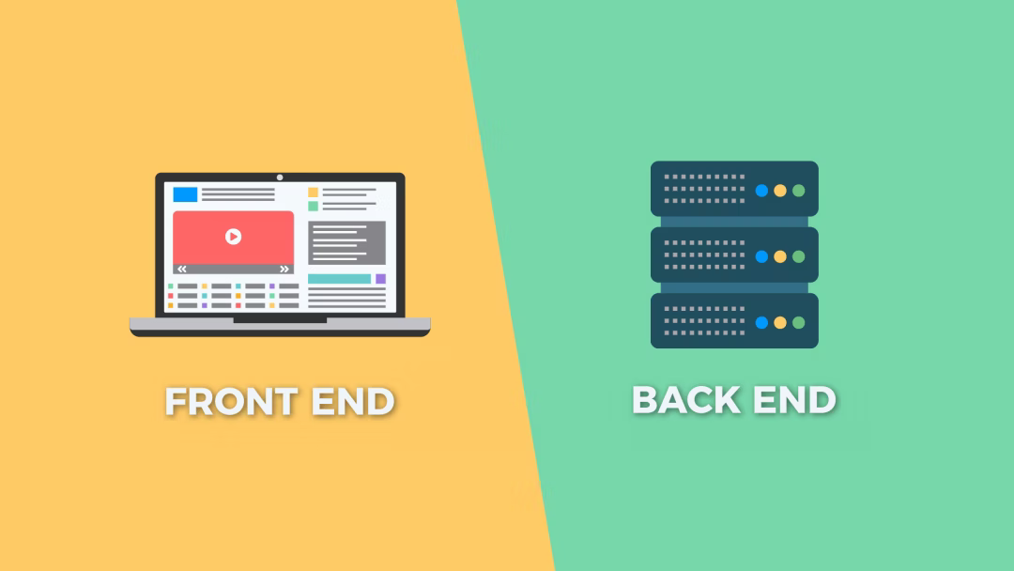
Project Working Requirements
Requirements:
IDE : Visual studio Code, Atom or sublime text
Browser : chrome or safari
Hardware Requirements:
RAM: 2GB min
ROM : 256 GB min
Programming:
Front End : React Js
Back End : supabase
Notes:
New Courses replaced with New Programmes

Slide 7
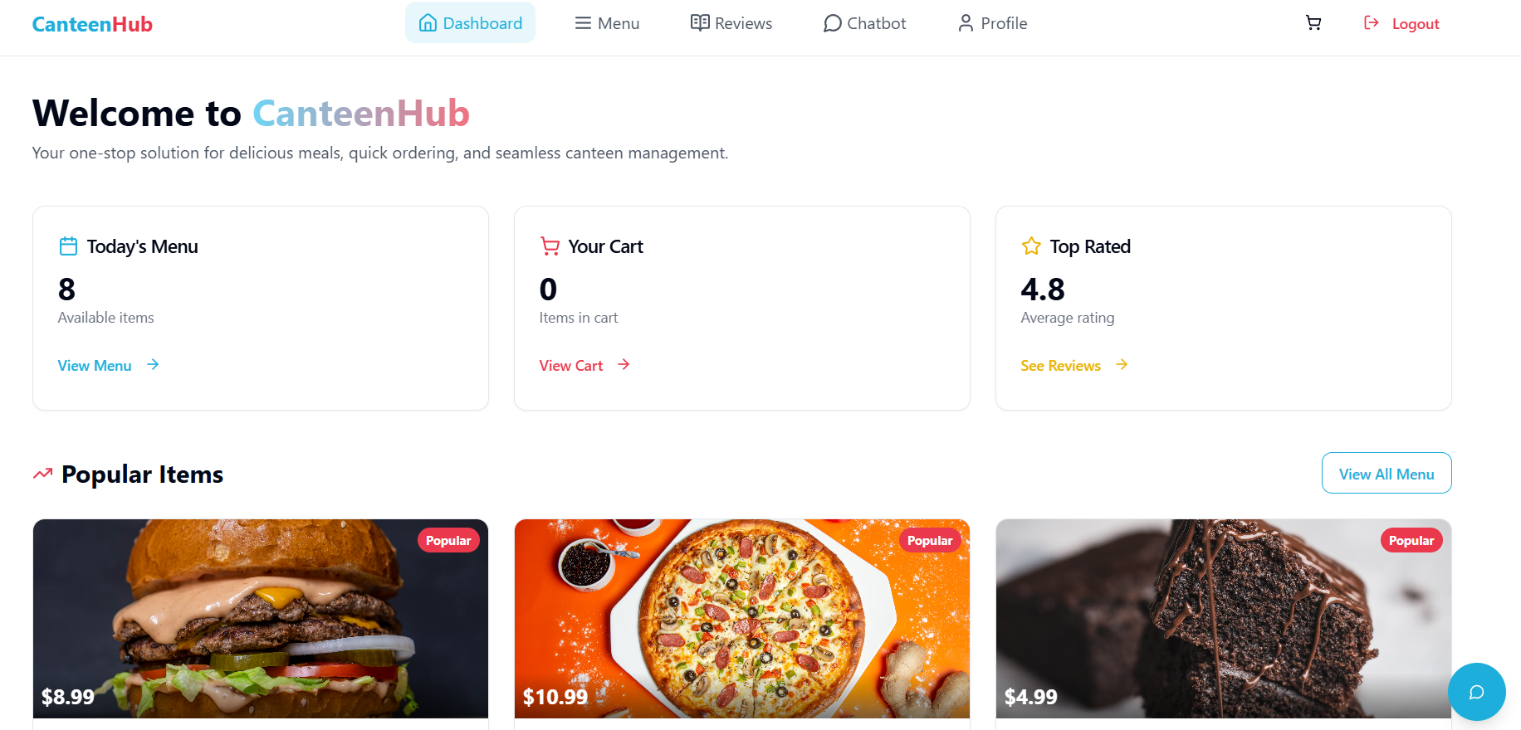
Front Page
Notes:
New Courses replaced with New Programmes

Slide 8
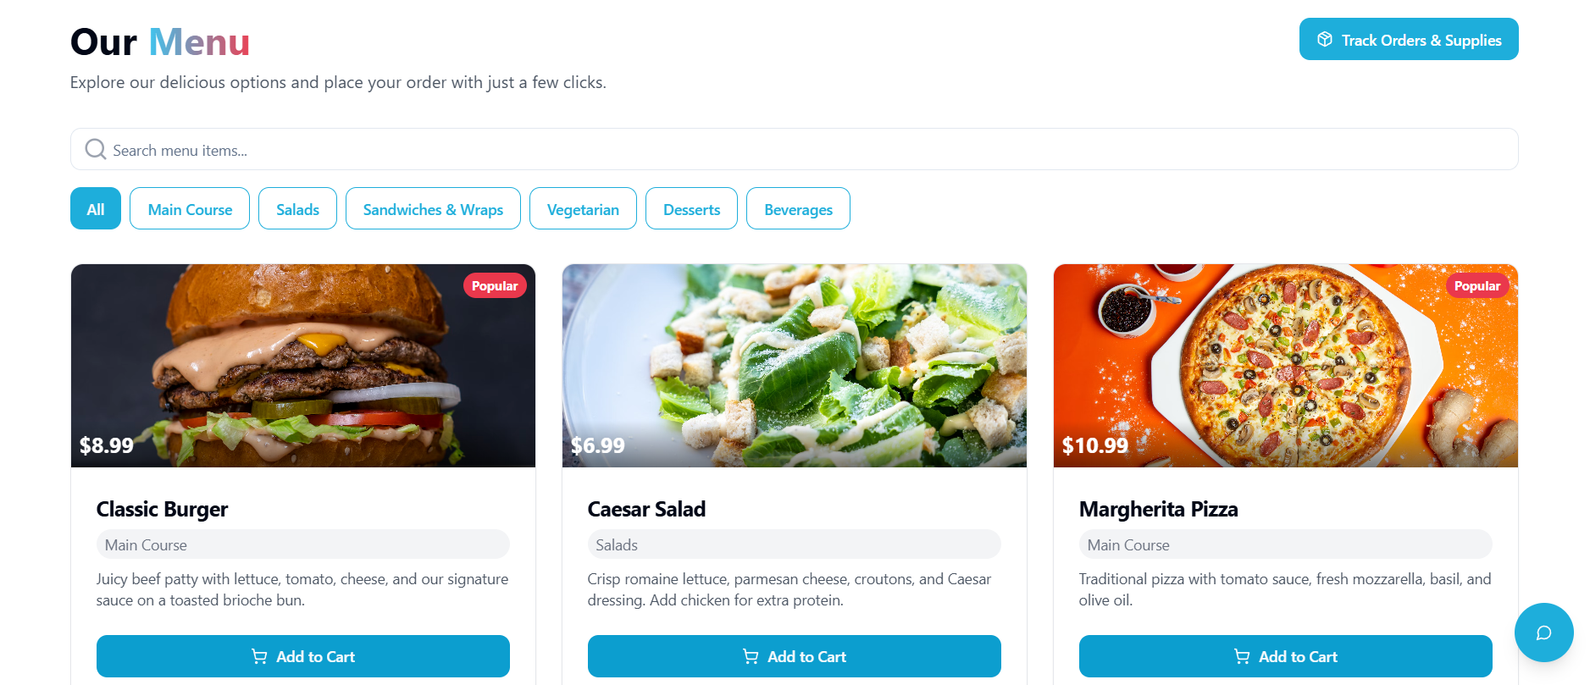
Our menu
Notes:
New Courses replaced with New Programmes

Slide 9
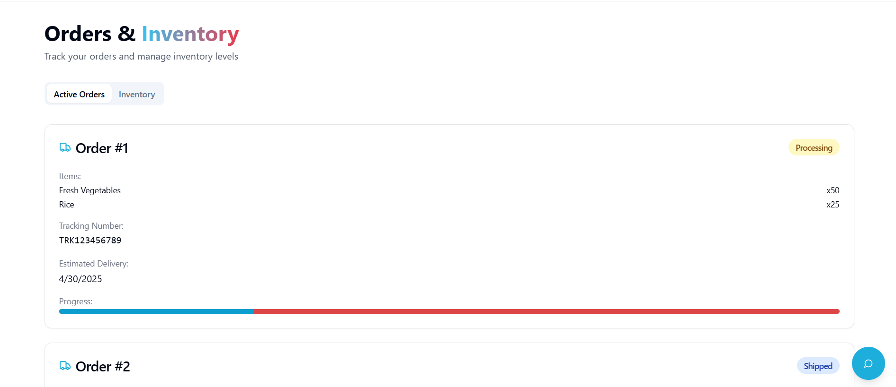
Track order
Notes:
New Courses replaced with New Programmes

Slide 10
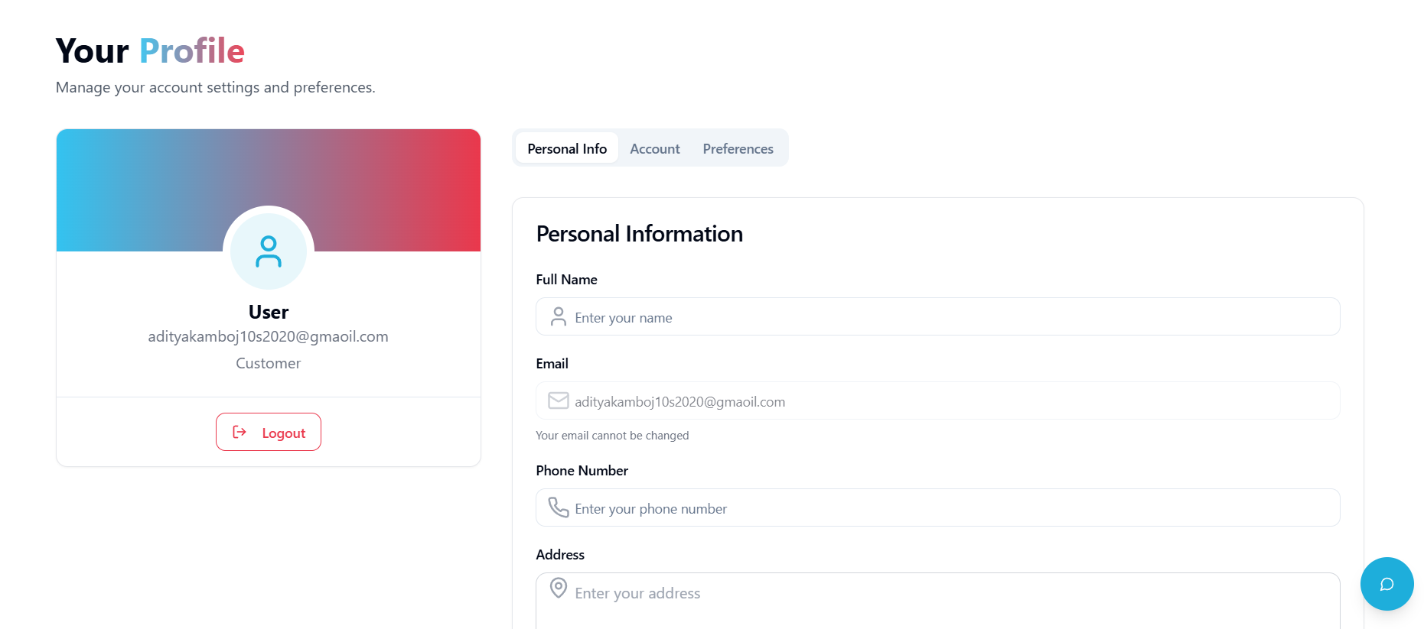
Admin profile
Notes:
New Courses replaced with New Programmes

Slide 11
Methodology Flowchart
Order Management System The system allows users to place orders for food items through an intuitive interface. Orders are processed in real time, and users receive updates on their order status [9].
Menu and Inventory Management Admins can update the menu, add or remove food items, and manage inventory. The system ensures that unavailable items are not listed for orders [9].
User Interface with EJS and Bootstrap The frontend is developed using EJS for dynamic templating and Bootstrap for responsive design, ensuring a user- friendly experience across devices.
Backend with Node.js and Express.js Node.js and Express.js handle the server-side logic, including managing user requests, processing orders, and handling authentication [6].
Notes:
New Courses replaced with New Programmes

Slide 12
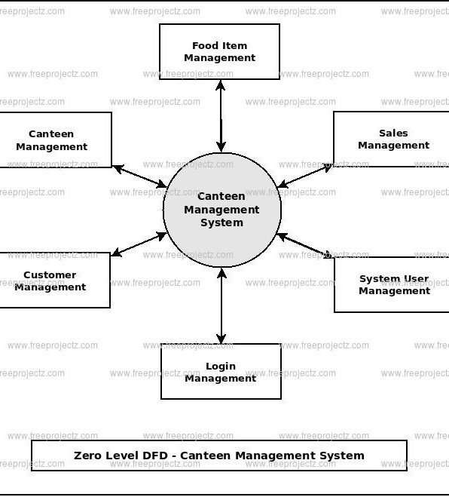
Methodology Flowchart
Database with MongoDB MongoDB is used to store user details, orders, menu items, and transaction records, providing a scalable and efficient data management solution.
Real-Time Updates and Notifications The system uses WebSockets to provide real-time order updates to users and can send email notifications for order
Notes:
New Courses replaced with New Programmes

Slide 13
Project Timeline
Phase | Tasks | Duration
Research & Analysis | Market research, technology selection | 2 weeks
System Design | Architecture, UI/UX design | 3 weeks
Development | Blockchain setup, QR code generation, web development | 6 weeks
Testing | Functionality testing, security testing | 3 weeks
Deployment | Launch, user feedback, optimization | 4 weeks
Total Duration | 18 weeks (~4.5 months)
Notes:
New Courses replaced with New Programmes

Slide 14
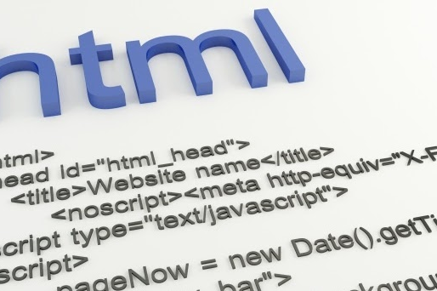
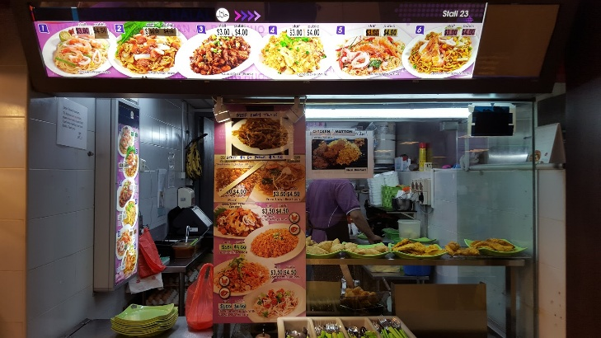
Methodology, Tools, and Techniques
Agile model
Admin access user and order tracking
Html css and react js is used to make it intreactive
web app (React js , html, supabase)
This Photo by Unknown Author is licensed under CC BY-SA-NC
This Photo by Unknown Author is licensed under CC BY-NC-ND
Notes:
New Courses replaced with New Programmes

Slide 15
Expected Results & Impact
expected Results:
A fully functional web-based canteen management system accessible through browsers.
Users (customers) should be able to:
View the digital menu easily.
Add items to cart and place orders online.
Track the real-time status of their orders (e.g., Preparing, Ready).
Make payments online or select Cash on Delivery option.
Admins should be able to:
Add, edit, or remove menu items.
View and manage orders placed by customers.
Track payment statuses and daily sales.
Update order statuses (e.g., Order Preparing → Ready for Pickup)
Final Outcome:
A responsive, user-friendly, and efficient canteen management web page.
Reduced queues and manual workload inside the canteen.
Notes:
New Courses replaced with New Programmes

Slide 16
Future Outcomes and scope
future Scope:
Mobile App Integration:
Develop an Android/iOS app version for easier access and faster ordering.
QR Code Ordering:
Customers can scan a QR code placed on tables or walls to directly view the menu and order without needing a separate website search.
AI-based Recommendations:
Suggest popular or favorite dishes to users based on their past orders using basic machine learning algorithms.
Inventory Management:
Real-time stock tracking for kitchen items to alert admins when ingredients are running low.

Slide 17
Conclusion
The Canteen Management System Web Page was developed to simplify and automate the traditional canteen operations by introducing an online platform for menu browsing, order placement, order tracking, and payment management. Through this system, the customers experience a faster and more convenient service, while the canteen staff benefit from reduced manual errors and better order handling efficiency.
The project successfully achieved its goals by creating a responsive, user-friendly interface supported by a reliable backend and database system. With the potential for future enhancements such as mobile app development, QR code ordering, and AI-driven recommendations, the system can be expanded to cater to even larger audiences and further improve the overall canteen experience.
This project not only demonstrates the application of web development and database management skills but also highlights the importance of digital transformation in everyday services like food ordering.
Notes:
New Courses replaced with New Programmes

Slide 18
References
Gupta, R., & Singh, P. (2021). Design and Development of an Automated Canteen Management System Using Python and MySQL. International Journal of Computer Applications, 12(5), 45-52.
"React Documentation." (2022). A JavaScript Library for Building User Interfaces. Retrieved from https://reactjs.org/
"MongoDb Documentation." (2022). Mongodb Database Management System. Retrieved from https://dev.mongo.com/doc/
Patel, V. & Sharma, D. (2020). Canteen Management System Using Web Technologies: A Review. Journal of Software Engineering, 18(3), 114-120.
Tailwind CSS Documentation. (2022). Tailwind CSS - A Utility-First CSS Framework. Retrieved from https://tailwindcss.com/
"Node.js Documentation." (2022). Node.js JavaScript Runtime. Retrieved from https://nodejs.org/
Chacon, S., & Straub, B. (2014). Pro Git. Apress. Retrieved from https://git-scm.com/book/en/v2
GitHub. (n.d.). GitHub Documentation. Retrieved from https://docs.github.com/
Beck, K., et al. (2001). Manifesto for Agile Software Development. Agile Alliance. Retrieved from https://agilemanifesto.org/
Vercel. (n.d.). Vercel Documentation. Retrieved from https://vercel.com/docs
Notes:
New Courses replaced with New Programmes

Slide 19
THANK YOU

